Slide 1

Data Science Platforms
Group Presentation – TEAM 10 (INFO 6105)
Akshata Honaro | Nancy Jemimah | Rushali Udhani | Sonal Thube

Slide 2
What is Data Science
A recent study conducted by Markets and Markets predicts the market for data science platforms will climb to $101.4 billion by the year 2021
Tool sprawl is a common challenge for data science teams.
Tool Sprawl- There are so many tools to help any organization to complete their monitoring picture, but no tool does everything and most organizations use many tools to help complete their monitoring solution. Mashing tools together often creates a problem of its own- this is the tool sprawl problem.

Slide 3
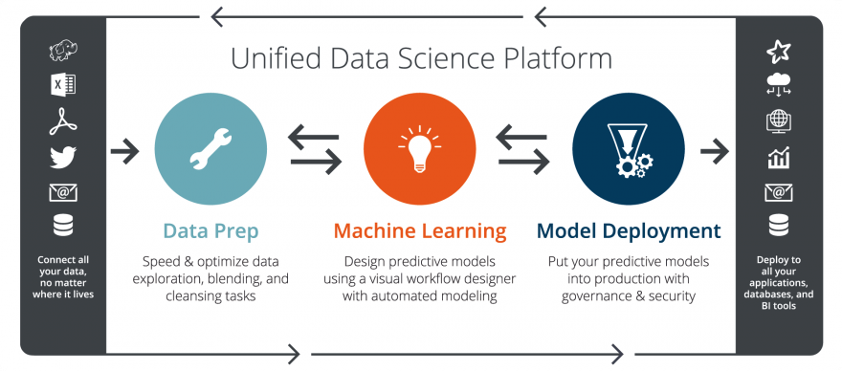
Life Cycle of Data Science platforms
A data science platform is a framework of the entire life cycle of data science project “
Phases of Life Cycle-
Data ideation, integration and exploration
Model Development
Model Deployment

Slide 4


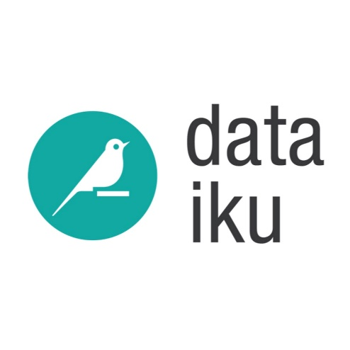
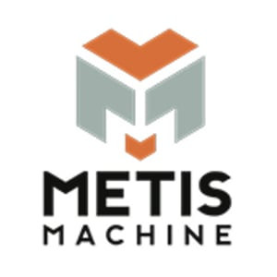
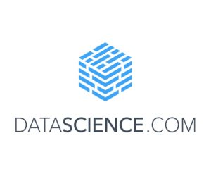
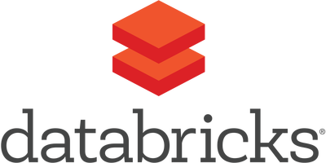
Data Science Platforms
Metis machine
Datascience.com
Domino
Databricks
Dataiku
Paperspace

Slide 5
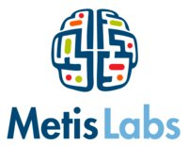
What Metis Machine does?
Elevates your Machine Learning (ML) workflow from proof-of-concept to production
Seamlessly deploy, manage, monitor, and integrate models into your applications and products
Install the Skafos Command Line Interface (CLI)
Platform that holds it all together
build, train, deploy and monitor their models independently

Slide 6
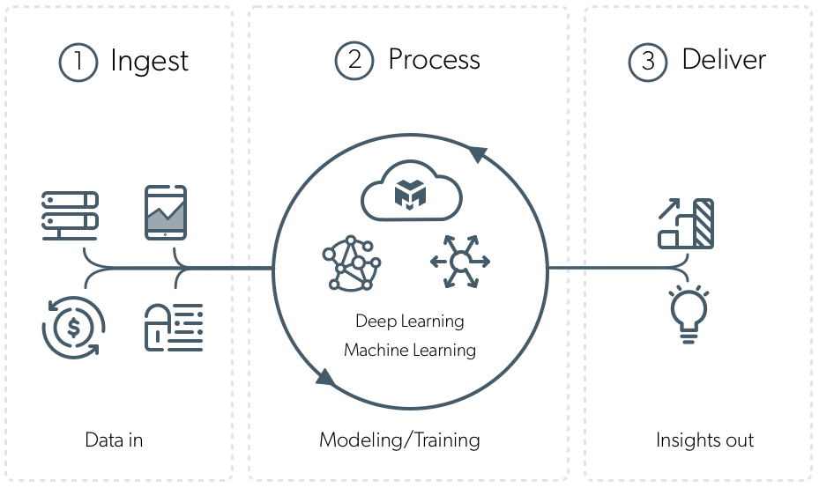
Inspiration and Purpose behind Metis Machine

Slide 7
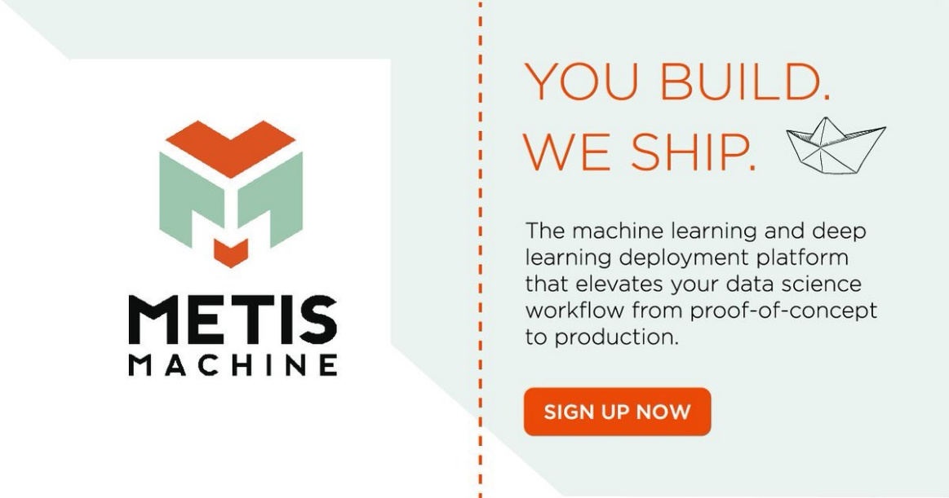
Guide from zero to AI hero
Sign up for a Skafos account
Create a iOS ML project using the Skafos Dashboard & Quickstart
Configure your iOS app to use Skafos
Now it's time to configure your Xcode project, install our Skafos framework, and add a few lines of code to tie it all together.
Jump up and down with excitement - you did it! You are now an AI hero

Slide 8
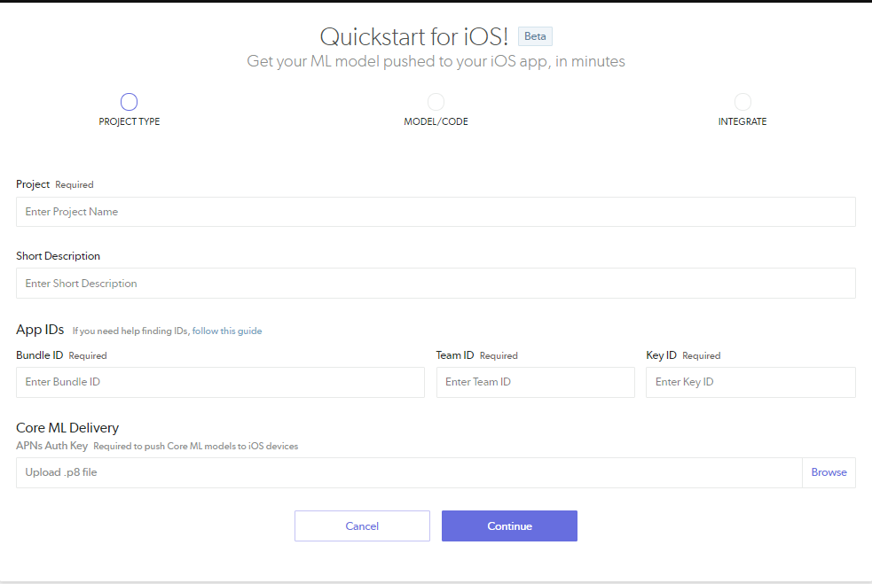
Integrating your App with Metis Machine

Slide 9
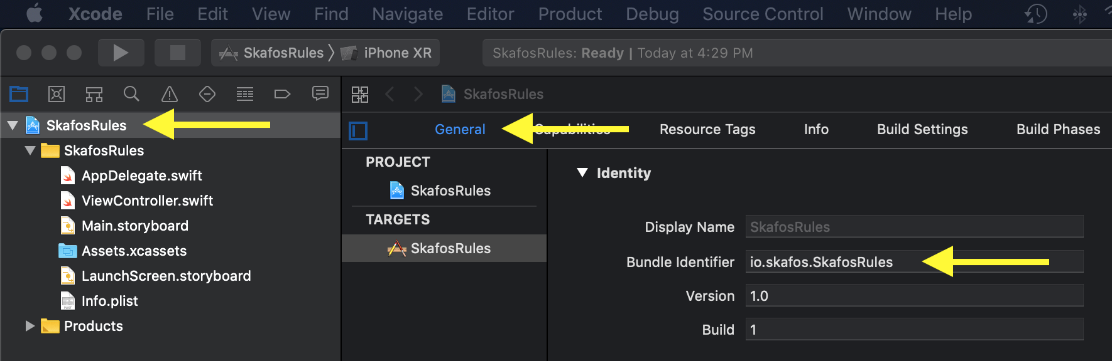
Finding Bundle Identifier

Slide 10
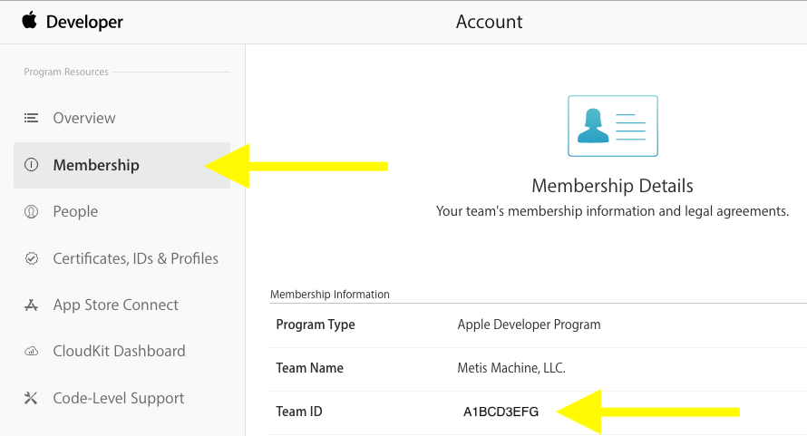
Finding Team ID

Slide 11
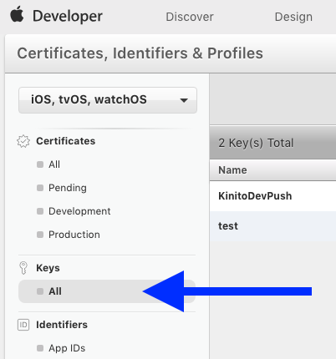
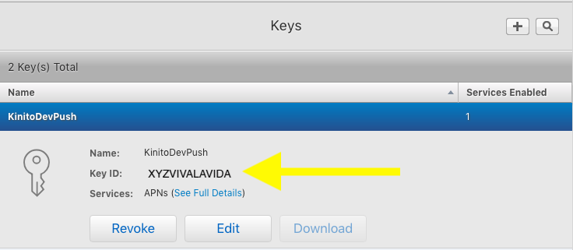
Finding Key ID

Slide 12
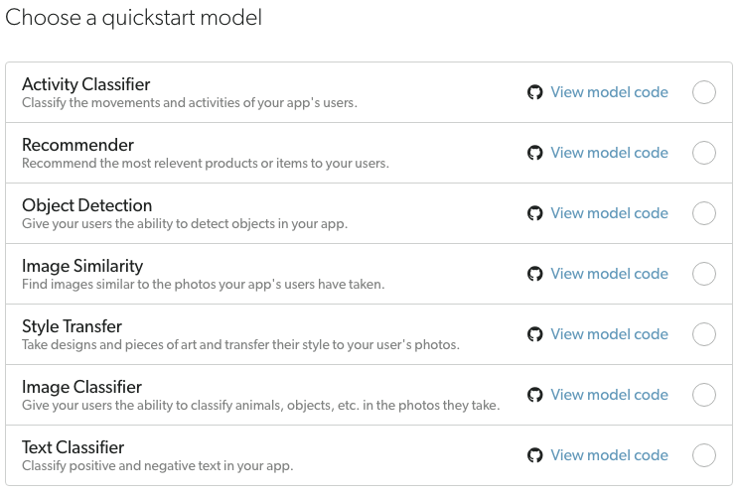
Metis Machine – ML Models

Slide 13
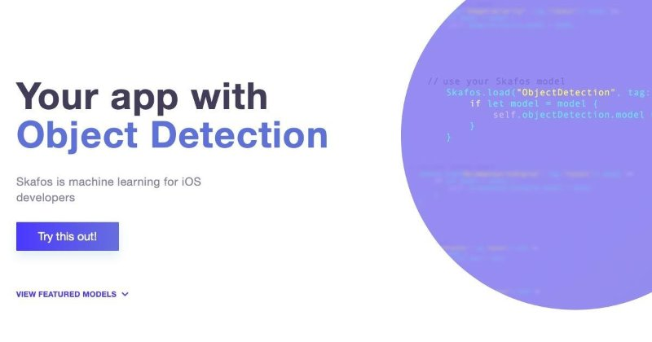
Time to integrate your app.
You have now created a Skafos project, and you will get a series of prompts explaining how to set up your app in Xcode with the necessary certs and Skafos framework to tie it all together. To do that, follow the directions provided here:
Configuring your iOS app to use Skafos

Slide 14
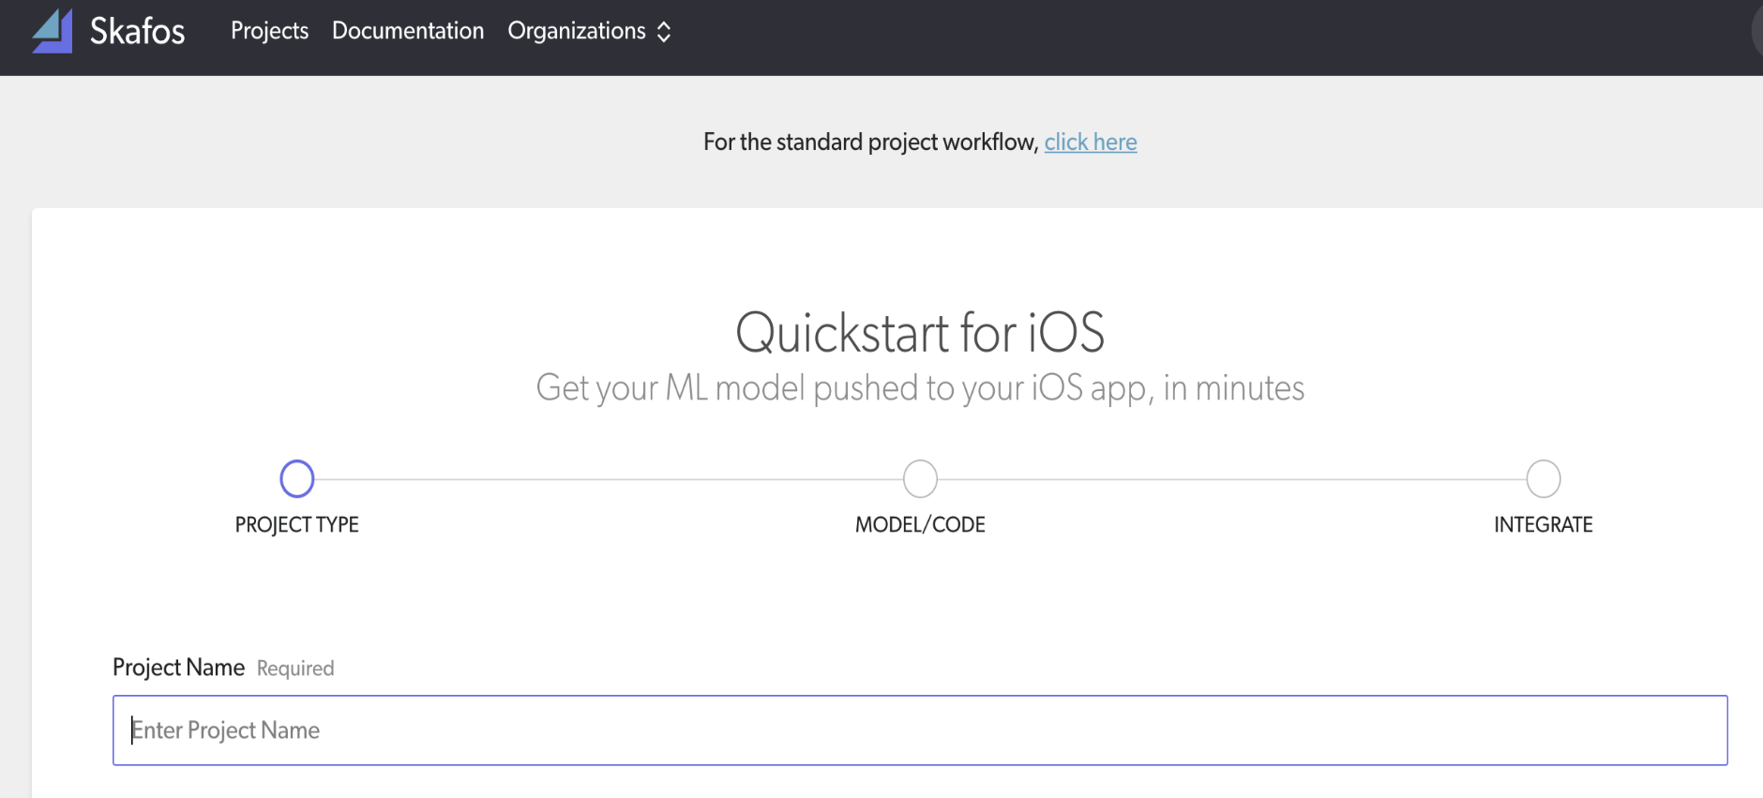
Quickstart step-by-step for Data Scientists
Go to the standard project workflow

Slide 15
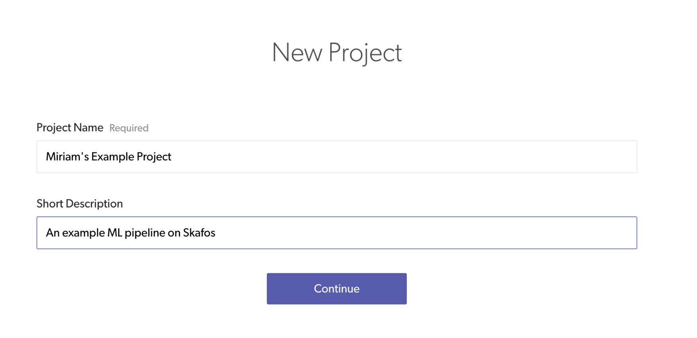
Add a Project Name and Short Description

Slide 16
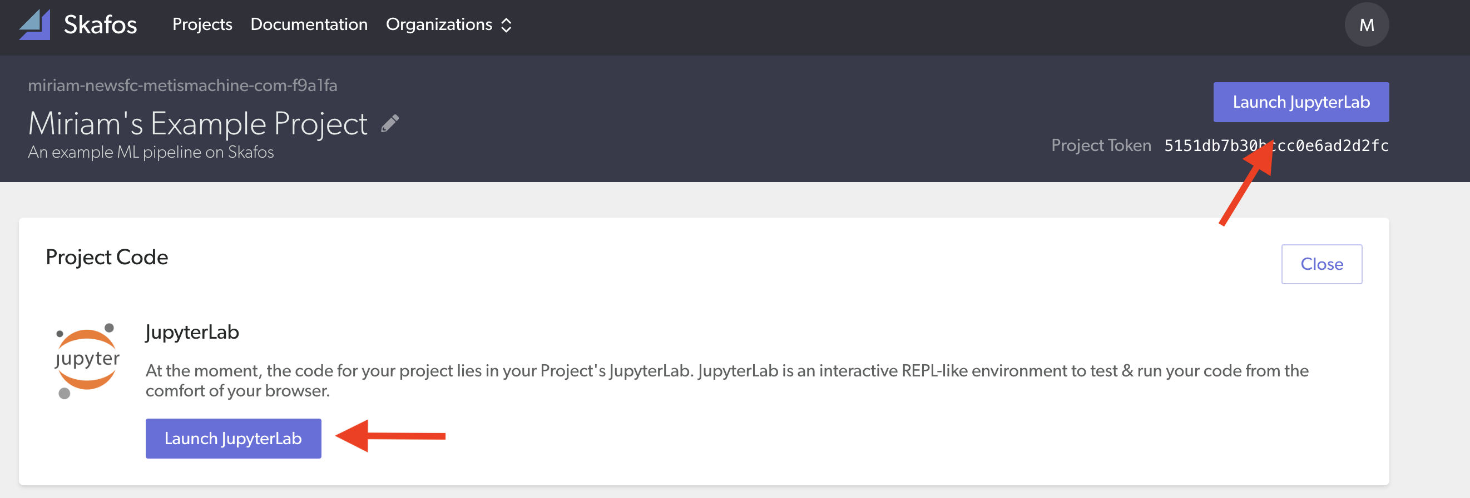
Launch JupyterLab

Slide 17
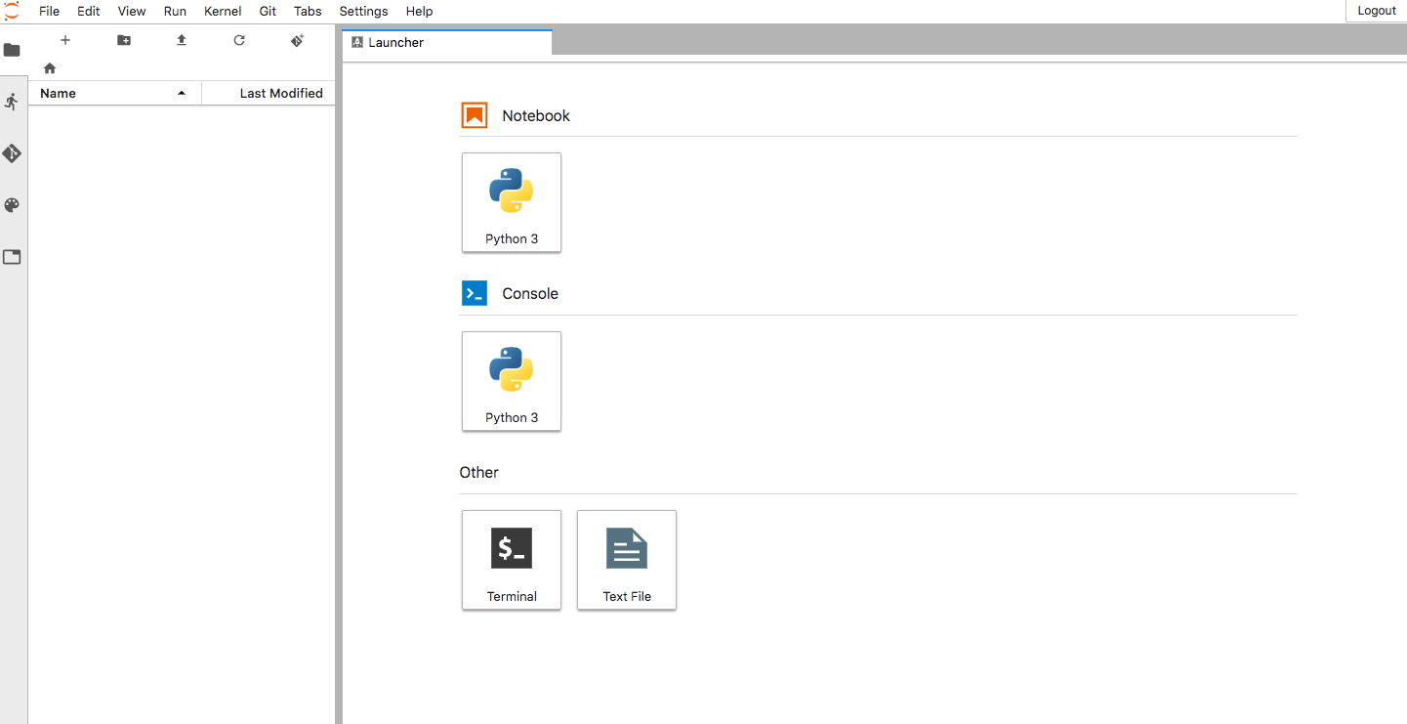
Use this project to create a new Skafos project

Slide 18
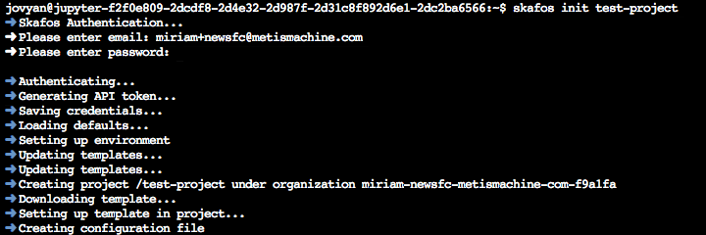
Create a Skafos Project from Scratch

Slide 19
Create using Skafos CLI
We recommend that you open a Terminal, and use the Skafos CLI to create a new project. You can:
Create a Skafos Project from Scratch
Create a Skafos Project from Existing Code

Slide 20
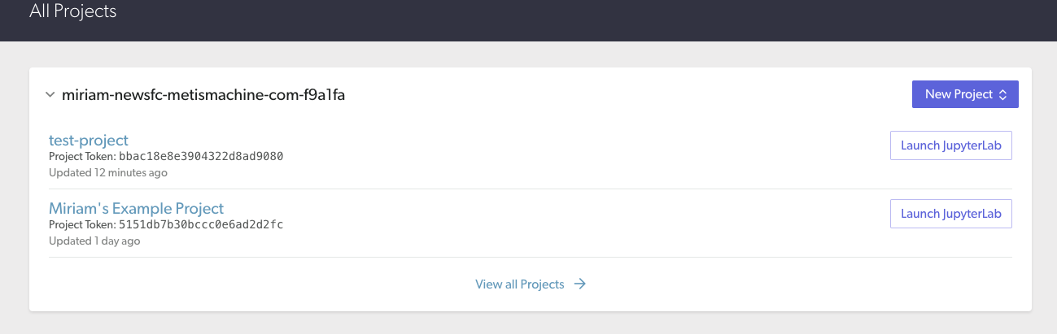
Skafos tab in your browser - new project will now be listed

Slide 21
Code, explore, and deploy
Now that you have created a new Skafos project, you can write code, add jobs, leverage Spark, and leverage the Skafos SDK.

Slide 22
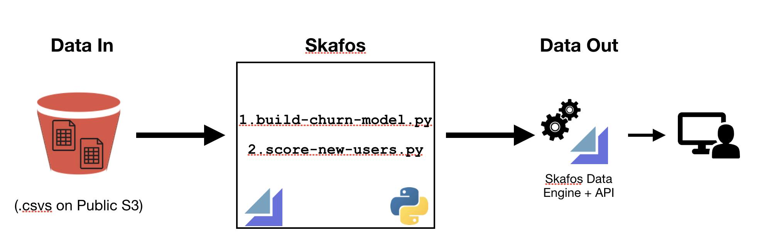
Utility of Skafos, Metis Machine's data science operationalization and delivery platform

Slide 23
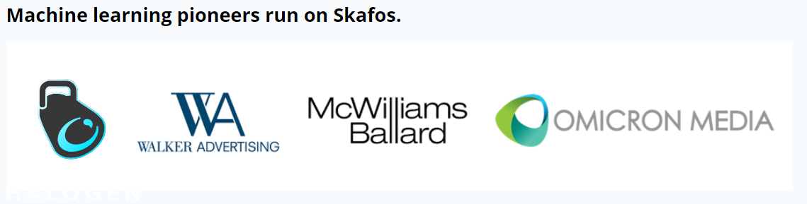

Slide 24
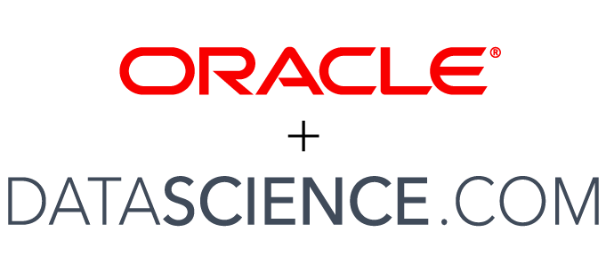
What datascience.com do?
On June 6, 2018, Oracle completed the acquisition of DataScience.com.
Embeds Artificial Intelligence (AI) and machine learning capabilities across its software as a service (SaaS) and platform as a service (PaaS) solutions.
Together, Oracle and DataScience.com will provide customers with a single data science platform that leverages Oracle Cloud Infrastructure and the breadth of Oracle's integrated SaaS and PaaS.

Slide 25
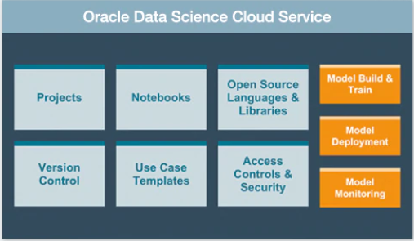
WE’RE YOUR DATA SCIENCE HUB

Slide 26
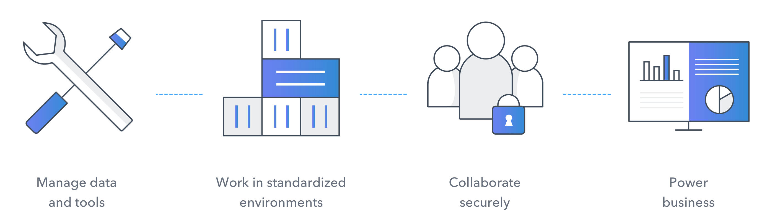
Flow of datascience.com

Slide 27
Main Aspects of datascience.com
The DataScience.com Platform combines the tools, libraries, and languages your team loves with the infrastructure and workflows your organization needs. The Platform combines three key components:
Infrastructure - systems tasks (like spawning servers) are abstracted and handled automatically so data scientists can focus on the substance of their work
Tools - open source tools (like Jupyter, R Shiny, or modeling libraries) that data scientists need are integrated into a centralized place
Workflow - automation for tasks, collaboration, and communication that let data science teams effectively deliver on their mission

Slide 28
How the DataScience.com Platform Turns Insights into Action
Companies are struggling to get the return on investment they desire from data science
Find out how the DataScience.com team build the enterprise data science platform that gives data science teams the tools they need to get the job done, as well as a framework for sharing results across their organizations. need.

Slide 29

Real-time business that uses datascience.com

Slide 30
Domino
Domino provides an open, unified data science platform to build, validate, deliver, and monitor models at scale.
This accelerates research, sparks collaboration, increases iteration speed, and removes deployment friction to deliver impactful models.
There are 3 layers in Domino
1) Infrastructure
2) Model Factory
3) Management Consoles

Slide 31
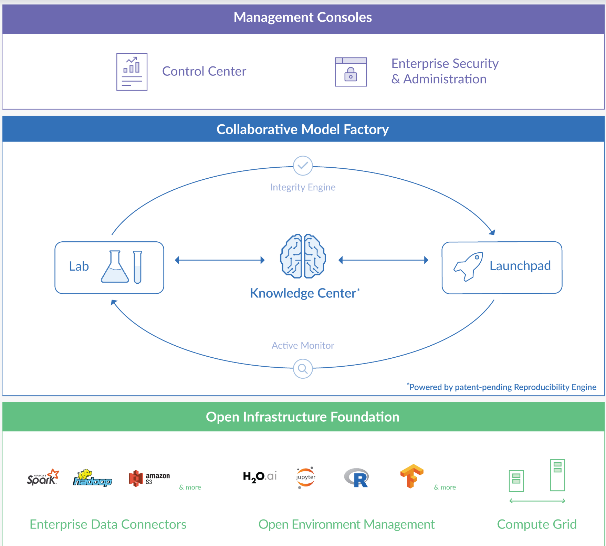

Slide 32
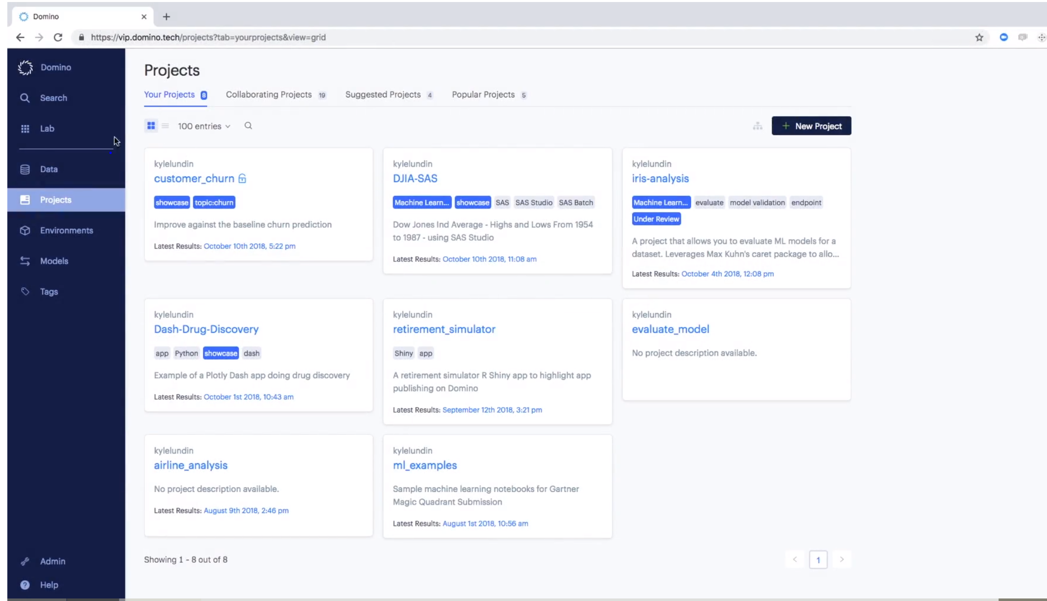

Slide 33
Three Key Areas of Domino
Lab
It is the place where Data Scientist spend time in building model and collaborating with one another.
Launchpad
It is the place where model products such as applications, model API’s are centrally published in access by various stakeholders across the business
It tracks user engagement with each app so creators can see who is using the model product and when
Control Center
It is the place where Data Science and IT layers can have visibility of all the activities taking place in domino to help manage their portfolio better.

Slide 34
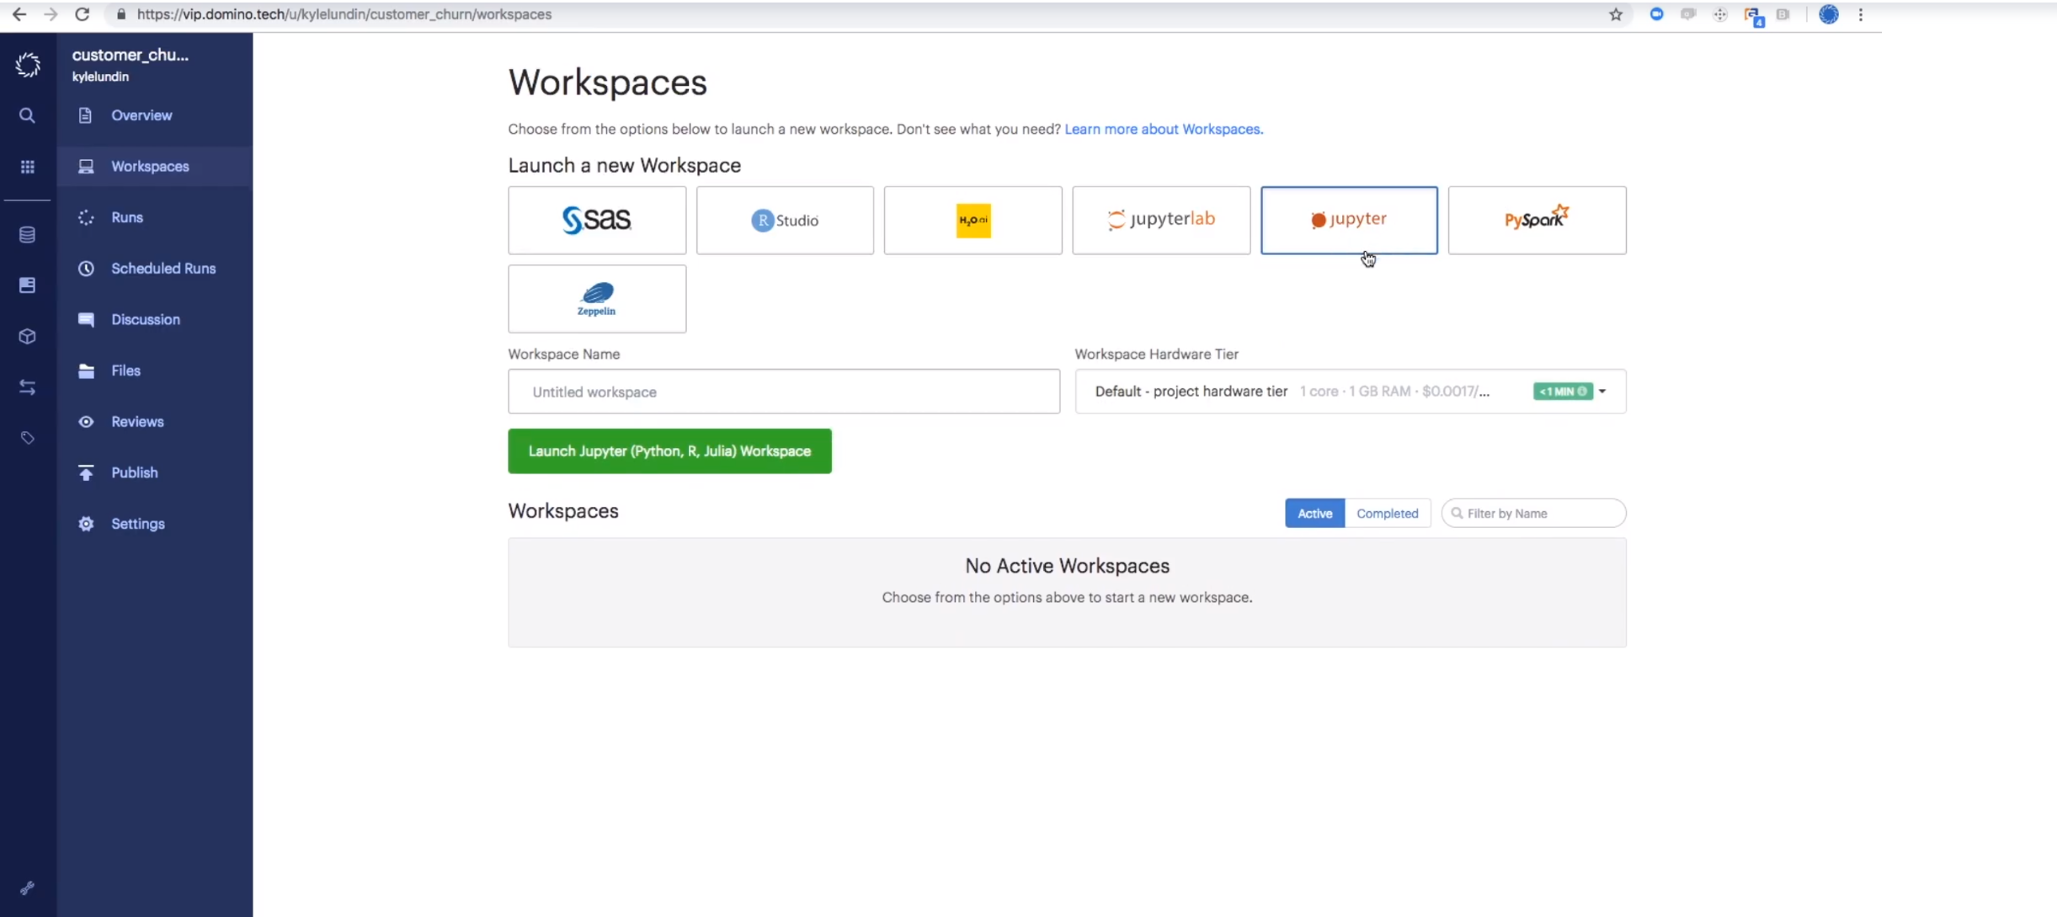
Accelerate research with your choice of innovative tools

Slide 35
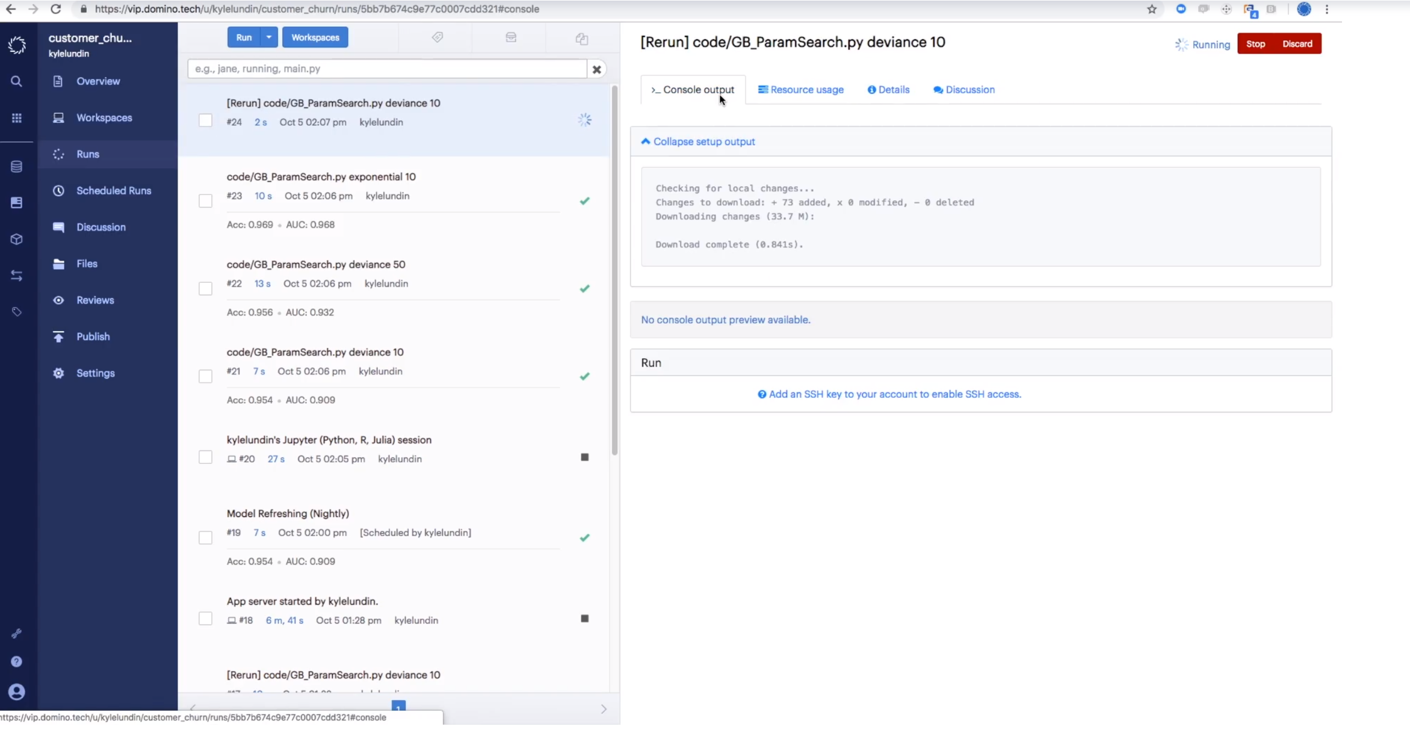
Eliminate re-work and painful reconstruction of experiments
Domino’s Reproducibility Engine automatically tracks
all the experiments, so you never lose work and
can always reproduce the results.
It keeps code, packages, environment details, data,
discussions, hardware used, tools used,parameters
and results for each experimental step.
It reduces the friction in iteration of model
and someone can pickup where another
data scientist left off.

Slide 36
Advantages
Domino indexes all the work that happens in the platform, so you can search for projects, files or comments easily.
In Domino each project has its own unique file system, so it not just stores the source code but also data, scripts, notebooks, model files of any file type.
In Domino you can select any size of hardware tier and future workload will be executed on that size machine.
It provides various software and environment to build model and the environments are sharable with your colleages.
In Domino we can run 10’s and 100’s of experiments at once and select highest performing model
In Domino consumers can view details of app, access them and interact with model while authorized people can see the feedback they receive regarding model to increase quality of model.

Slide 37
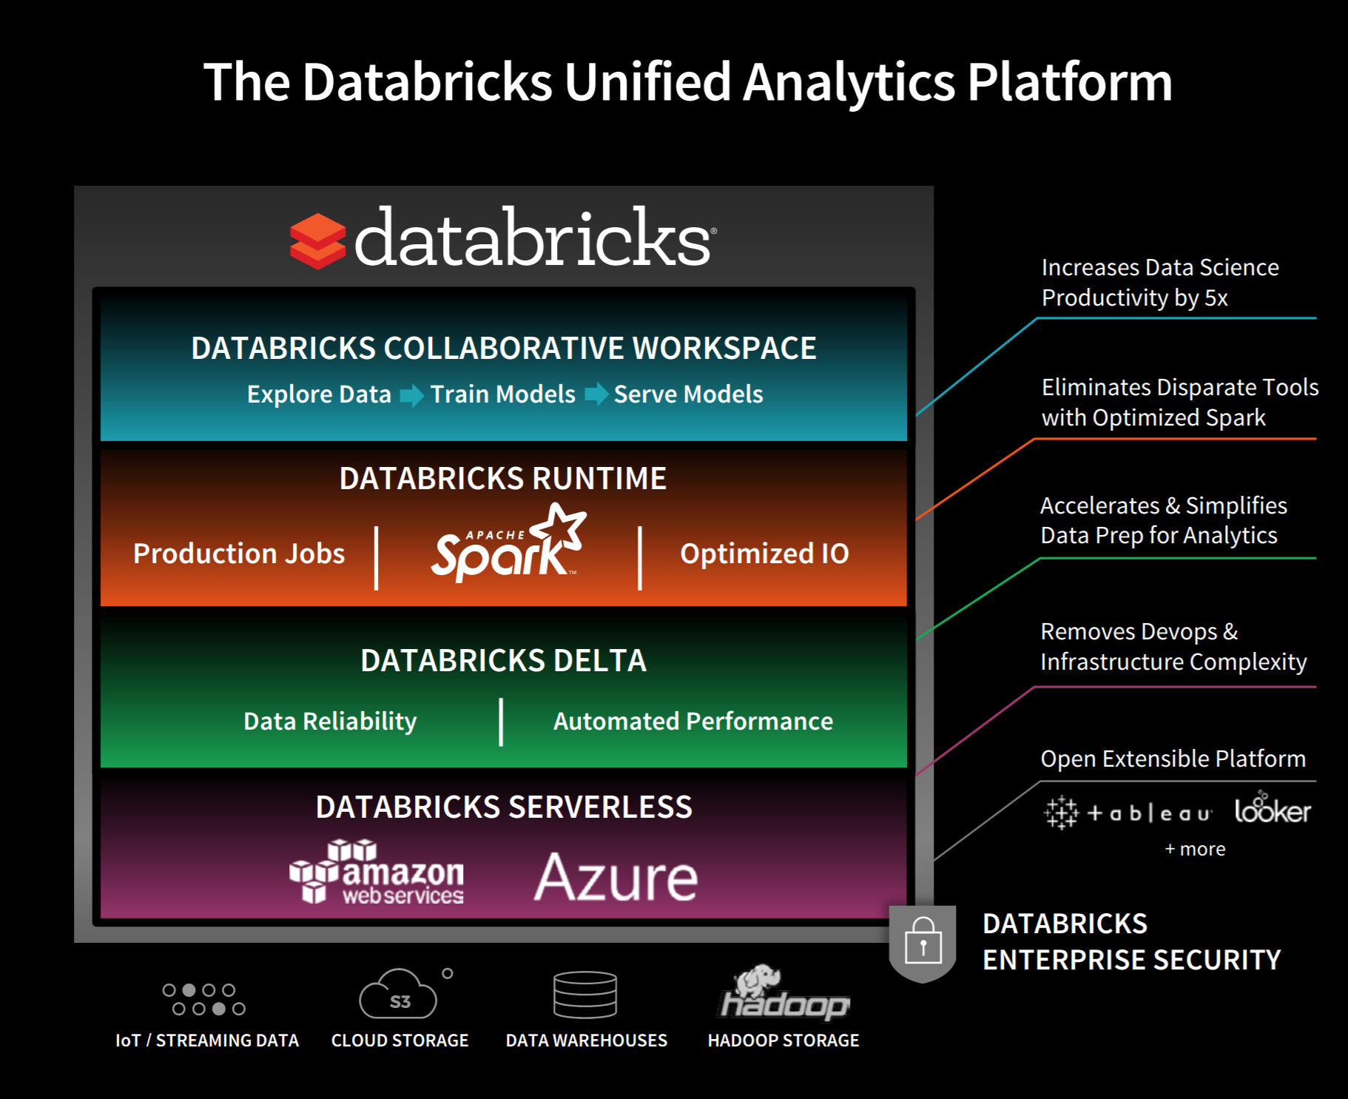
Databricks
Databricks is a platform which provides ideal solution to challenges like data growth, infrastructure complexity, disparate technologies, disjoint analytics workflow, siloed teams and protecting the data by unifying data engineering, data science and business

Slide 38
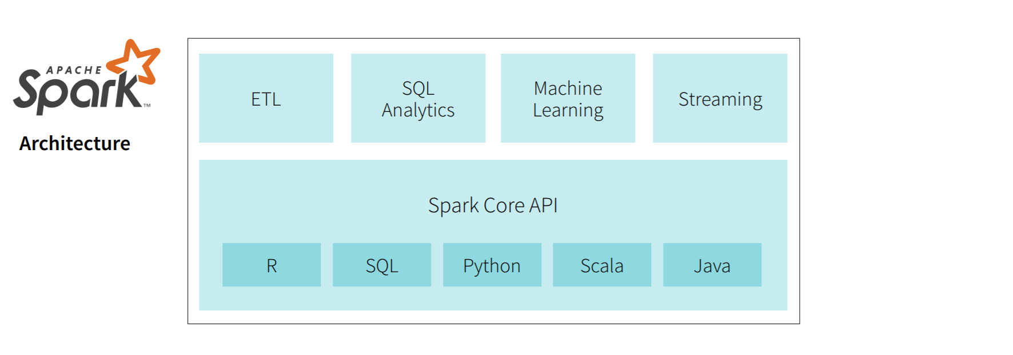
Apache Spark

Slide 39
Demo
https://www.youtube.com/watch?v=WaxMj5_SLUI

Slide 40
Dataiku
Dataiku's single, collaborative platform powers both self-service analytics and the operationalization of machine learning models in production.
It provides a collective platform for data project process from data preparation to application deployment on single UI.

Slide 41
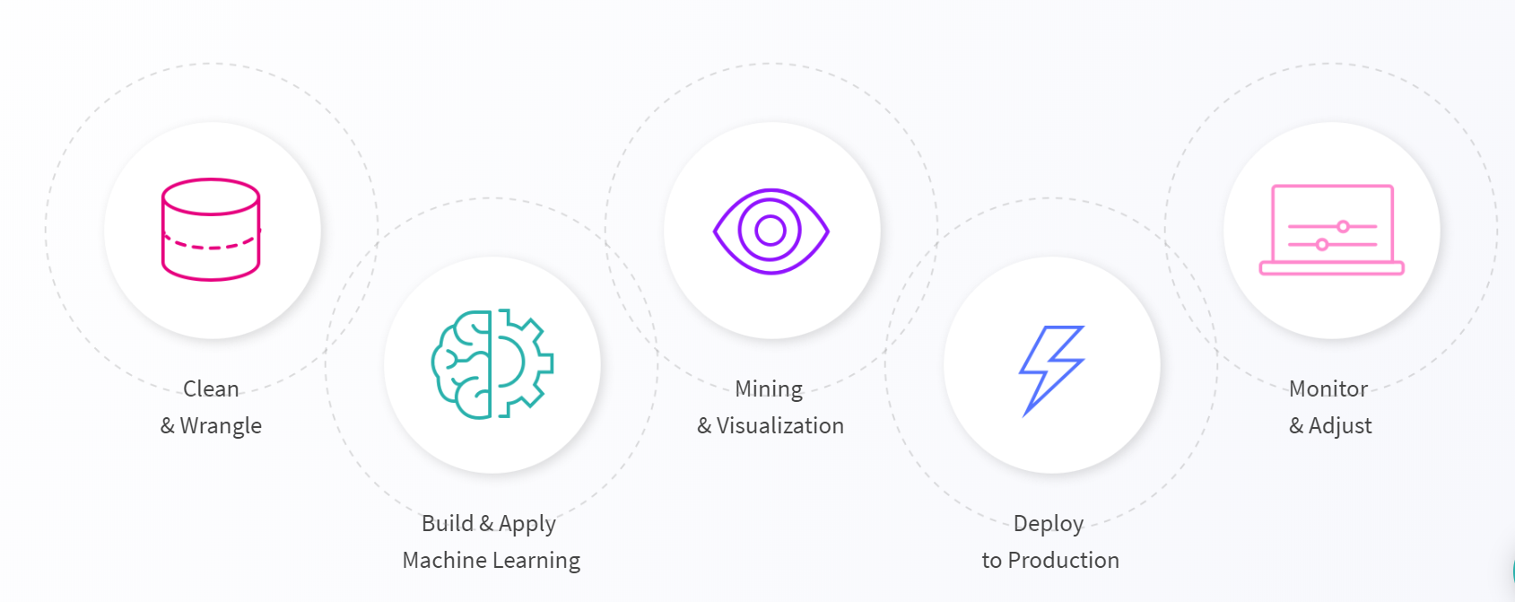
Features provided by Data Science Studio

Slide 42
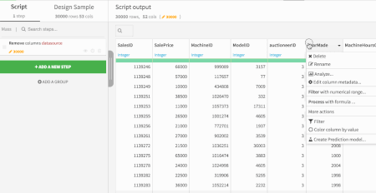
Clean and enrich data interactively
Visual Data Transformation
INTERACTIVE DATA CLEANING AND ENRICHMENT
SIMPLE INTERFACE TO INTERACT WITH DATA
Integrated ADVANCED PROCESSORS

Slide 43
Build and apply machine learning:
AUTOMATED MACHINE LEARNING
Get instant visual insights from your model
Use pretrained models right from Dataiku interface

Slide 44
Deploying ML Models In Production
Deploy models in one click on the cloud with kubernetes
Deployed models are versioned, enabling users to deploy new versions, compare them and rollback at anytime.
Monitor data changes over time

Slide 45
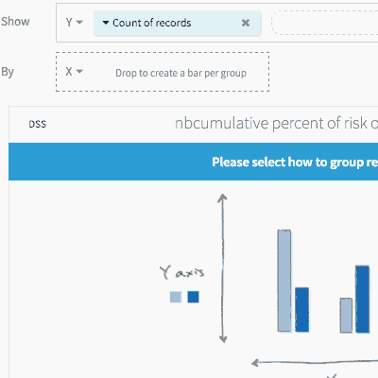
Data Exploration And Visualization
Drag and drop insights on your data
Visualise your datasets with builtin and custom charts
Python, r, and SQL interactive notebooks

Slide 46
Workflows, Automation, And Monitoring Governance, Security, And Monitoring
Scheduling of the events
Track the status of your production scenarios
Visualize the success and errors of your Dataiku jobs
Use dedicated Dataiku Automation nodes for production pipelines Connect and deploy on production systems (data lakes, databases)

Slide 47
Paperspace
Paperspace is a high-performance cloud computing and ML development platform for building, training and deploying machine learning models.
Cloud VMs with GPU support for gaming, designing and programming (ML/DL) needs. Offers latest NVIDIA GPUs along with pre-installed packages and a few DL frameworks at competitive prices.
a GPU is a processor that is specially-designed to handle intensive graphics rendering tasks.

Slide 48
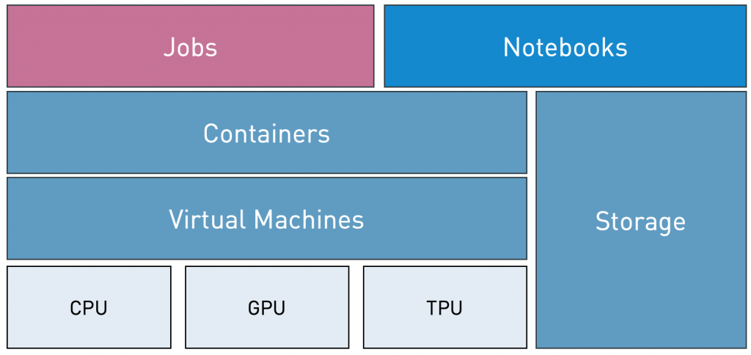
Paperspace offers three products-
1. GRADIENT
Gradient° includes 1-click jupyter notebooks, a powerful job runner, and a python module to run any code with full power of the Paperspace GPU cloud.
3 components-
Jobs, notebooks, data/storage
https://support.paperspace.com/hc/en-us/articles/115004333473-Tutorial-Train-your-first-neural-network-

Slide 49
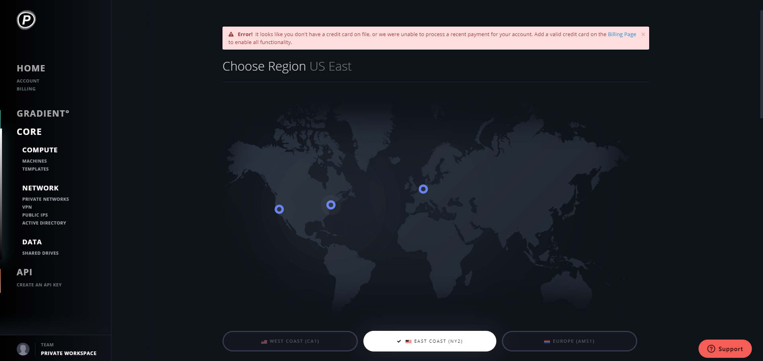
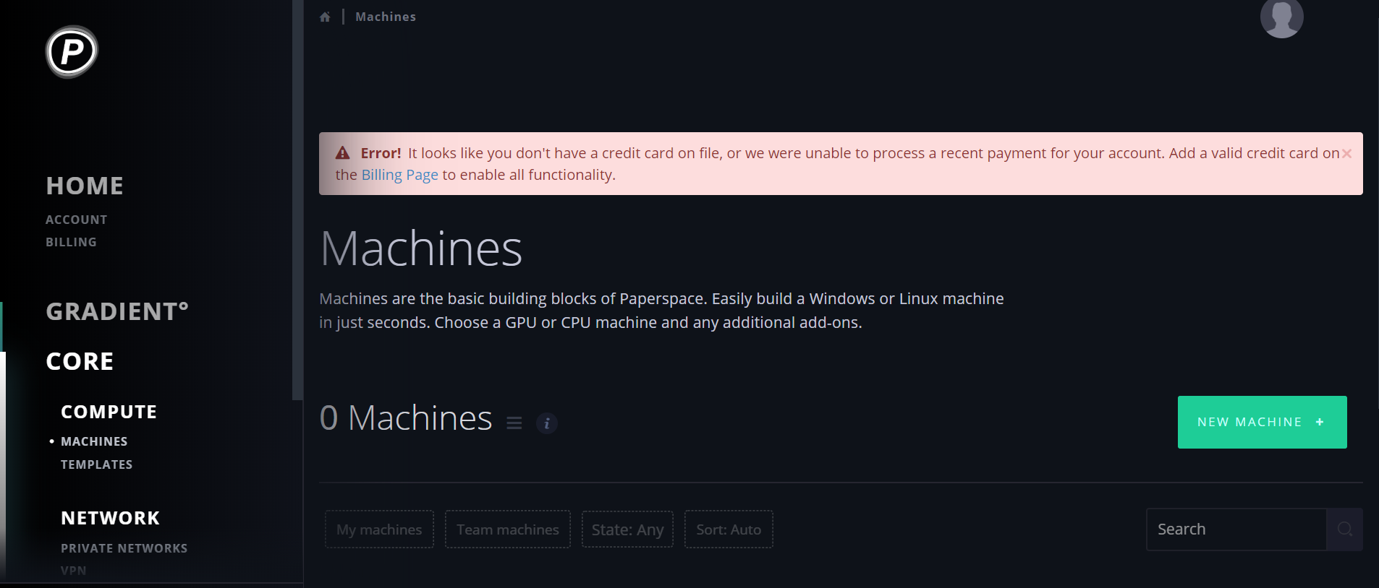
2. Core- Windows or Linux Desktops & Servers
Easily provisions a CPU or GPU accelerated Windows or Linux instance with a range of networking, storage, and OS options.
Paperspace offers full desktop environments as well as servers with SSH or web-based terminal access.

Slide 50
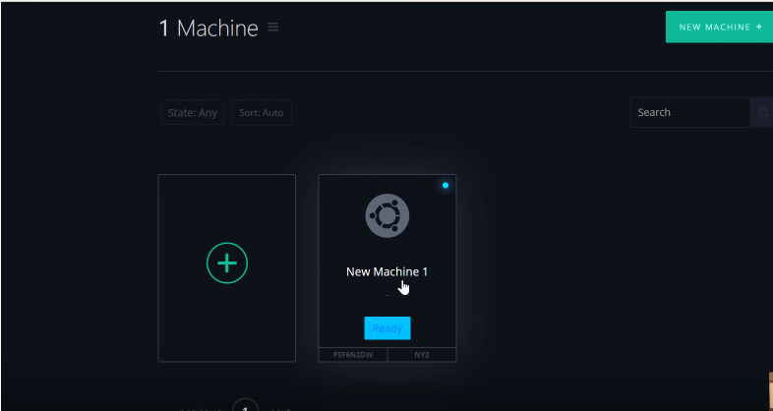

Slide 51
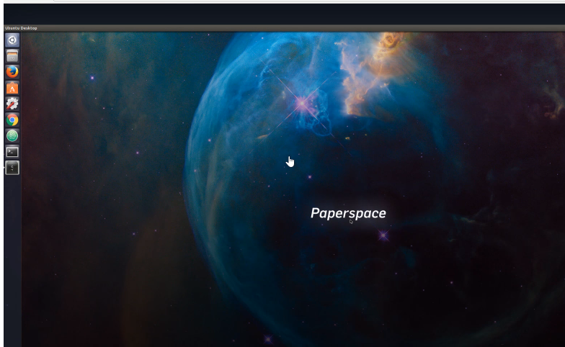

Slide 52
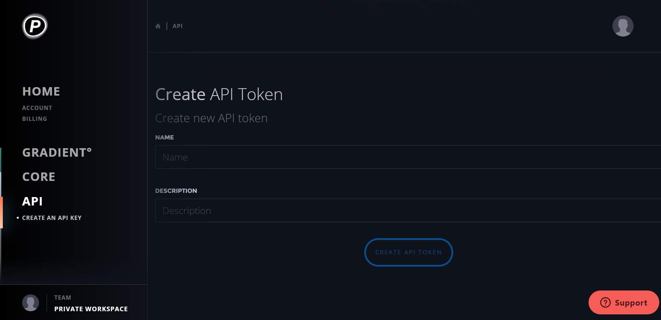
3. API
An entire GPU cloud at your fingertips. Build intelligence into your application with Paperspace API, the official devkit for automating your account.

Slide 53
Data Science Platforms used by Popular Companies
Domino- Dell, GAP, Instacart, Tesla, Eventbrite,Turnitin, and many more
Dataiku- Sephora, Comcast, Unilever, Fox, Santander, Capegemini
Databricks- Viacom, hp, Shell, Samsung, nbcUniversal

Slide 54
“The only way to get more work done next week than last week, short of hiring, is to invest in efficiency … a data science platform is an investment in technological efficiency.”
- Kevin Novak, Head of Data Science Platform at Uber.
Facilitate better collaboration among Data Scientists
Help Minimize Engineering Effort
Help Offload Many Low Value Tasks
Facilitate Faster Experimentation and Research

Slide 55
Reference Articles
https://docs.metismachine.io/docs
https://medium.com/metis-machine/the-inspiration-and-purpose-behind-the-metis-machine-platform-ca2c10eef30
https://cloud.oracle.com/en_US/sign-in
https://www.datascience.com/

Slide 56


Slide 57


